Slide 1
FHIR Roadmap
Intro, Regulations & Roadmap
Lloyd McKenzie

Slide 2

Who am I?
Name: Lloyd McKenzie
Company: Gevity
Background:
One of FHIR’s 3 initial editors
Co-chair FHIR Management Group and FHIR-Infrastructure
HL7 Fellow
Heavily involved in HL7 and healthcare exchange for last 20 years (v2, v3, CDA, etc.)
lmckenzie@gevityinc.com

Slide 3
Introduction to FHIR

Slide 4

FHIR is…
A new healthcare exchange standard
®
HL7 v2
CDA
®

Slide 5

FHIR is…
A modern, cheaper, faster, more flexible approach

Slide 6

FHIR is…
A toolbox
140+ resources
20 exchange mechanisms
100s of extensions
>100 IGs

Slide 7


FHIR is…
A platform

Slide 8
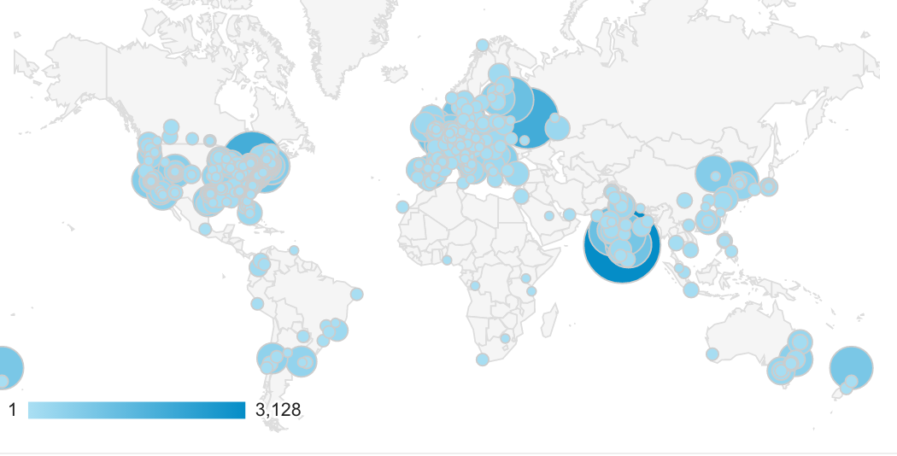
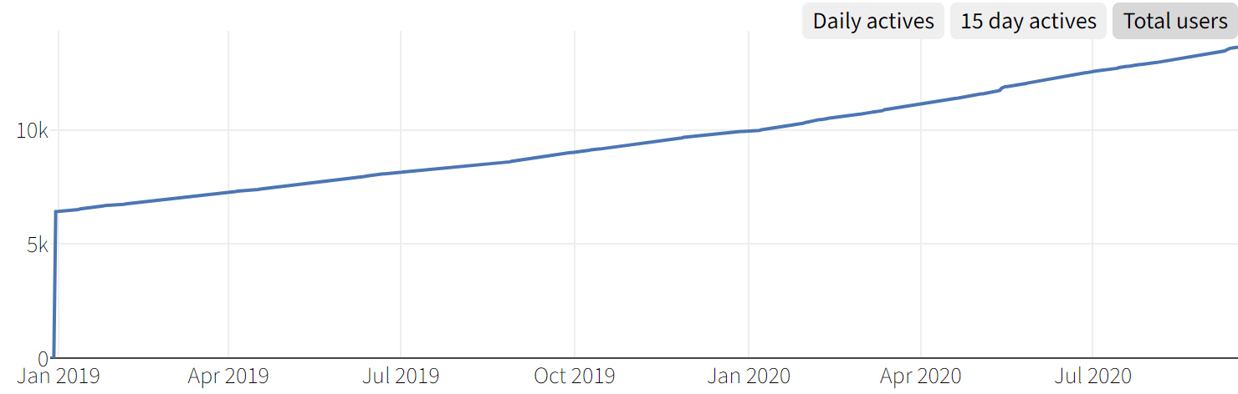







FHIR is…
A community

Slide 9
Summary
FHIR is a new healthcare exchange standard that is a modern, cheaper, faster, and more flexible. It provides a set of building blocks to build interoperability solutions and serves as a foundation to new technologies that change what healthcare IT can accomplish. It has built an enormous community that is passionate about transforming healthcare

Slide 10
Regulatory space

Slide 11
ONC Cares act
Must have a patient API
Must support FHIR R4.0.1 (or newer versions with partner agreement)
US Core
Bulk Data
SMART App launch
Must be turned on, allow patients to use software of their choice, reasonable cost

Slide 12
CMS Interoperability & Patient Access
Also FHIR 4.0.1 + U.S. Core, SMART App Launch
Also
CARIN Blue Button IG
Da Vinci PDex
Provider data exchange
Member match
Drug Formulary
Provider directory

Slide 13
Future considerations?
TEFCA?
FDA?
Future ONC, CMS
FAA?

Slide 14
Roadmap to R5

Slide 15
R5 is taking longer
The bigger FHIR gets, the more work
at least when most stuff isn’t yet locked down
Market seems to want time to consume R4
COVID reduces capacity
Current timeline:
Start balloting May 2021, Publish mid 2022
Could slip further?

Slide 16
R5 plans
More Normative Resources
Allergy, meds, Condition, ServiceRequest, Encounter, etc.
More mature resources
Bumps to maturity level
A few new resources
Evidence based medicine, public health?

Slide 17
R4b
There’s pressure to put out certain resources ‘sooner’ than the R5 timeline
Medication regulation, Evidence-based medicine
R4b, tentatively for 2021 Q2 publication
Identical to R4 other than specified resources

Slide 18
What else to expect
More IGs
More from FHIR ‘accelerators’
Continued work on specs that build on FHIR platform
SMART, CDS Hooks, FHIRCast, SMART Web messaging, …
Continued work on tools
Continued growth of community

Slide 19

Questions / discussion?
lmckenzie@gevityinc.com
(or PM me on http://chat.fhir.org)

